Slide 1
Expense Tracker
By: Burke Havranek, Gaurav Koratagere, Ajey Sasimugunthan
Northeastern University - College of Engineering
Department of Electrical and Computer Engineering
EECE 2140: Computing Fundamentals for Engineers
Fall 2024

Slide 2

Introduction
Develop program that can track, analyze, and manage someone’s expenses efficiently
Provide advice on how to invest excess income
Help point out unnecessary expenses to user
Receive inputs from user that give us total story about their salary and where their money goes

Slide 3



Literature Review
Mint, YNAB, and PocketGuard
help people manage personal finances
Mainly help people budget their money and plan where income goes toward
Utilized experience gained in lecture to help on project including topics on loops, algorithms, classes, etc

Slide 4
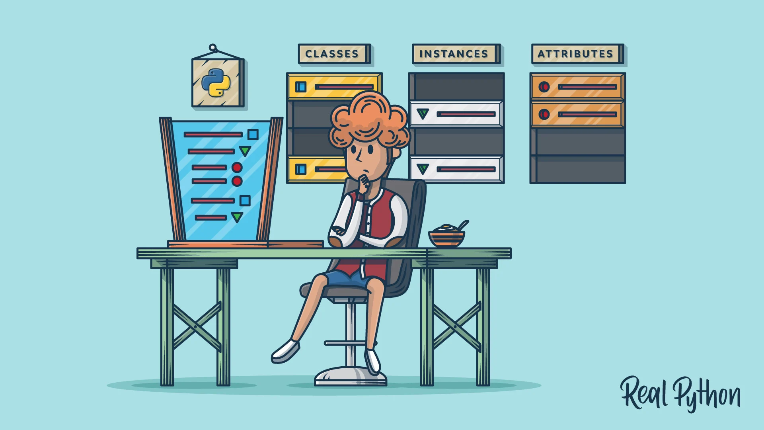

Methodology
Use of OOD principles
Classes, methods, objects etc.
Coding with Git
Branches
Source control
Comments and communication
Easier readability

Slide 5
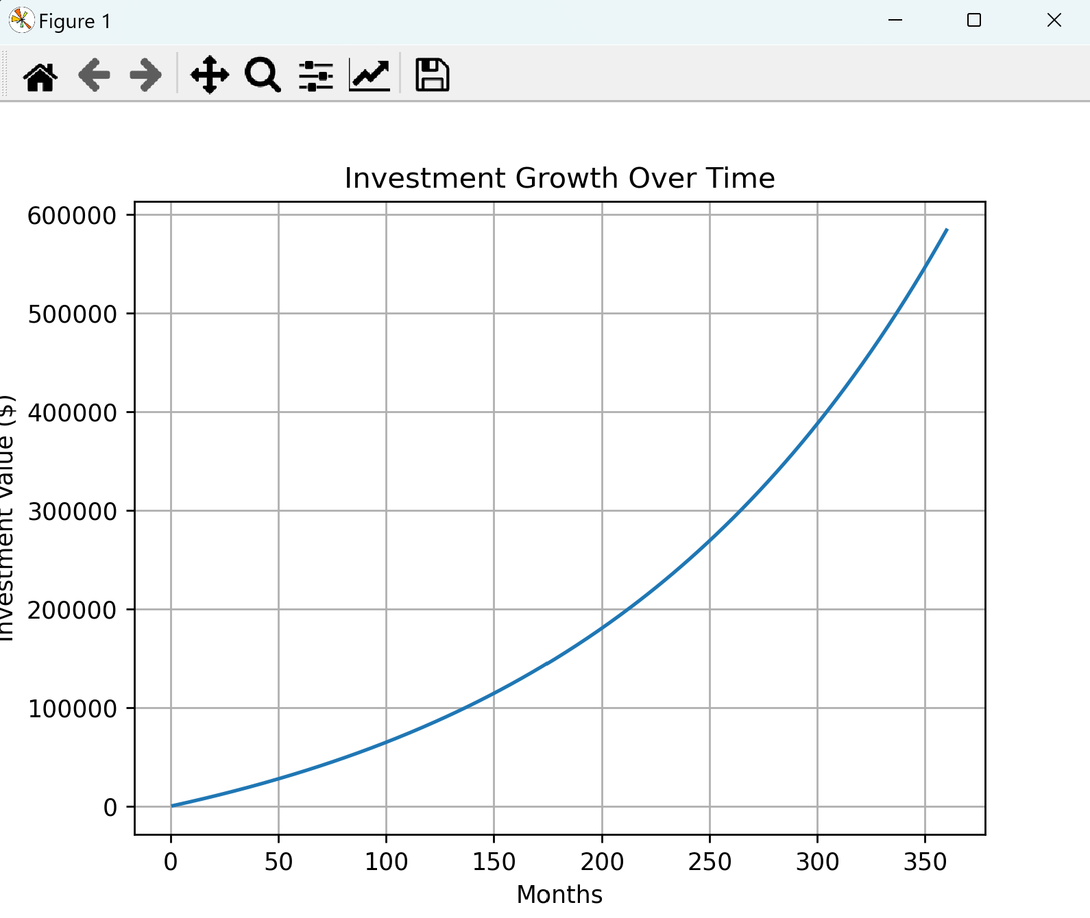
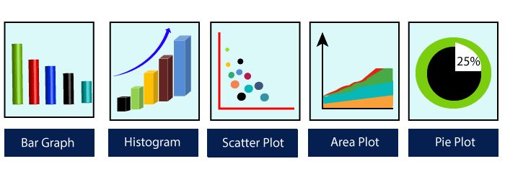
Analysis and Results
3 hours/ week, 12 hours/month per person
Base Numeric analysis
Numerical Expressions
Graphical representation
Projection and Operation
Use of MatPlotLib

Slide 6

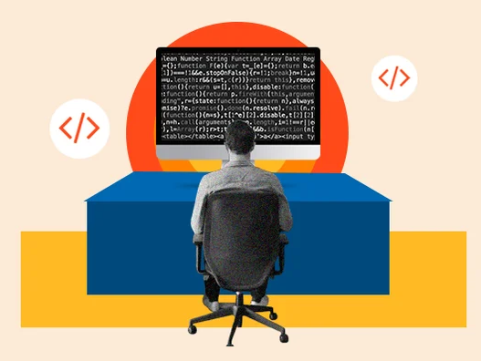
Discussion
Current apps are effective
User Privacy
does not hold onto users data
Limitation: Introductory Coding Class
Lack of Knowledge

Slide 7


Conclusion
Conclusion: Effective, but incomparable to established projects
Future Improvements:
Inclusion of GUI(Graphic User Interface)
Incorporation of APIs to get accurate, current investment options: Yahoo Finance, Alpha Vantage

Slide 8
References
matplotlib. (n.d.). Pyplot tutorial — Matplotlib 3.8.0 documentation. Matplotlib.org. https://matplotlib.org/stable/tutorials/pyplot.html
Mint. (2024). Budget Tracker & Planner | Free Online Money Management | Mint. Mint.intuit.com. https://mint.intuit.com/
Features | YNAB. (n.d.). Www.ynab.com. https://www.ynab.com/features
PocketGuard. (n.d.). PocketGuard | Your Personal Money & Bill Organizer. PocketGuard. https://pocketguard.com/

